Slide 1

Flight Tracker Case Study
Kunal Das
29/07/2024

Slide 2

Introduction
Every passenger needs a real-time update for their upcoming flight
A System is required to send notification to the passenger about their flight status, not limited to cancellation, delays etc.

Slide 3
Project Scope
The project can send email on changes found.
Uses third-party email service
Limited to UI for the end passenger, and not Admin.
Admin needs to feed in data using API tools, for now.

Slide 4
Approach
Passenger End: Let user add their email and flight number to register for email notifications.
Backend: Let Admin add and update flight data using tools like Postman for now.
Data Storage: Store data in three databases, flight collection, topic collection and user collection
Flight collection holds all the flight data
Topic collection holds all the flight name and their subscribed passengers
User collection holds admin users

Slide 5
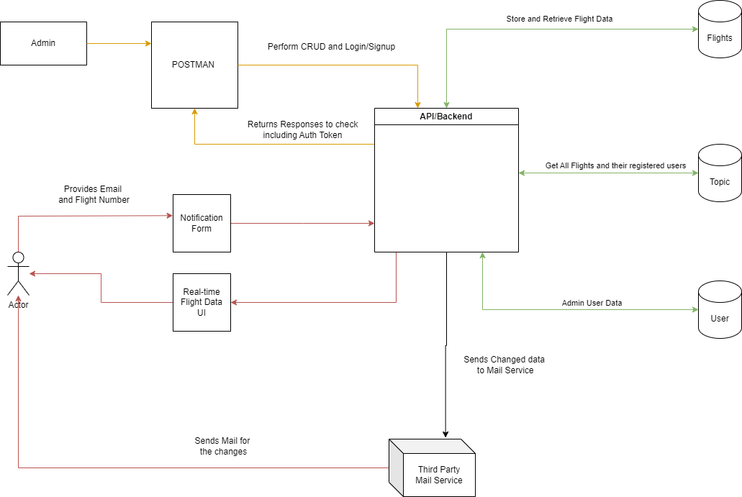
System Design

Slide 6
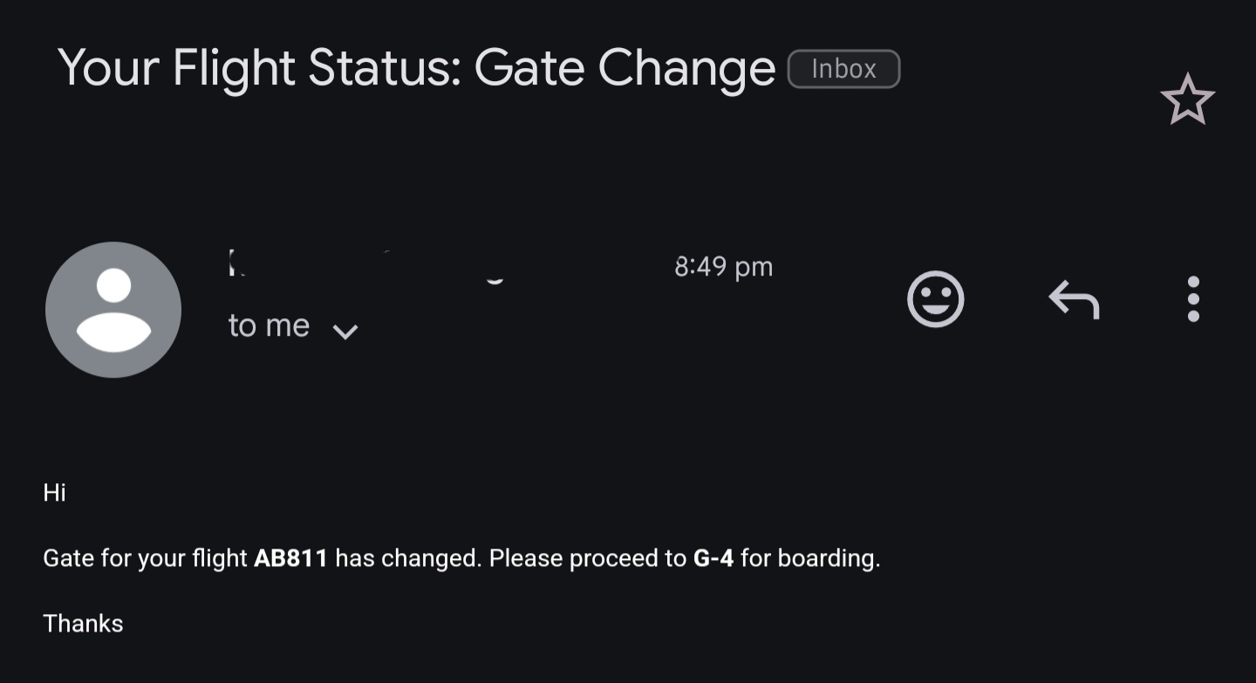
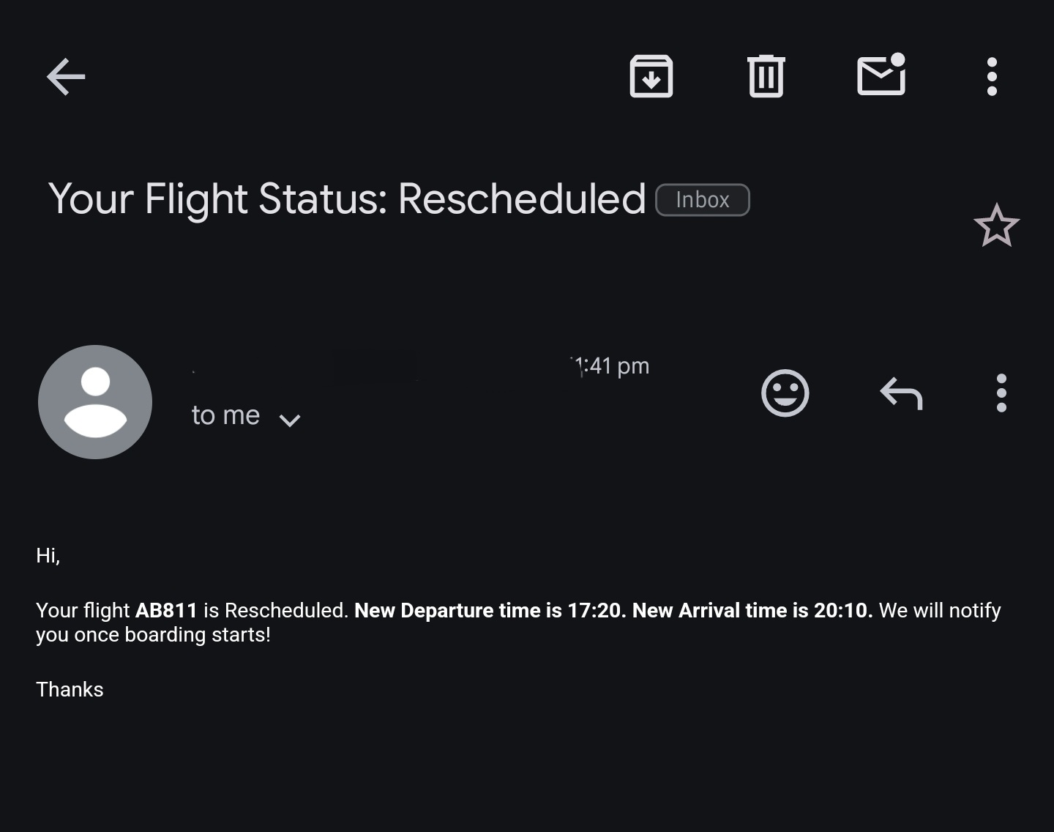
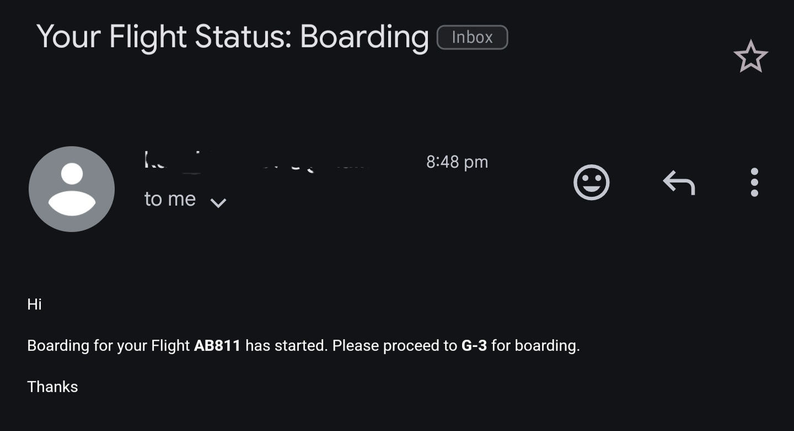
Results
An Email is successfully sent to the passenger
Mail is received in case of On Time, Rescheduled, Boarding, Cancellation, and Gate Change

Slide 7
Future Implementation
This project can be enhanced by adding a push notification, using RabbitMQ, and Websockets
Admin can have a UI

Slide 8
Thank You

